Slide 1
Grey scale image generation using GAN
Presented By:
M UDHAYA REKHA
513121104045
THANTHAI PERIYAR GOVERNMENT INSTITUTE OF TECHNOLOGY-VELLORE

Slide 2
Project Title
Grey scale image generation using GAN

Slide 3
Agenda
1.Problem Statement
2.Project Overview
3.End Users
4.Our Solution and Proposition
5.Key Features
6.Modelling Approach
7.Results and Evaluation
8.Conclusion

Slide 4
Problem Statement
The problem of generating high-quality grayscale images using Generative Adversarial Networks (GANs) poses several challenges due to the inherent complexity of the task. While GANs have shown remarkable success in generating realistic images, the focus has primarily been on generating color images. However, grayscale images are essential in various domains such as medical imaging, satellite imaging, and historical photograph restoration. The absence of color information in grayscale images makes the generation process more challenging, requiring careful consideration of texture, shape, and contrast.

Slide 5
Project Overview
The project aims to develop a robust framework for generating high-quality grayscale images utilizing Generative Adversarial Networks (GANs).
Grayscale image generation holds significant importance in diverse domains such as medical imaging, satellite imaging, and historical photograph restoration, where color information may be absent or unnecessary.
The primary objective of this project is to develop an efficient and effective GAN-based framework for generating grayscale images that exhibit realistic texture, structure, and detail.

Slide 6
Who are the End Users?
Medical Professionals
Researchers
Satellite Imagery Analysts
Historical Archives and Museums
Artificial Intelligence Developers
Digital Artists and Designers
Forensic Investigators

Slide 7
Our solution and its value proposition
Our solution for grayscale image generation using Generative Adversarial Networks (GANs) is a comprehensive framework that encompasses data preprocessing, model design, training strategy, evaluation, and deployment stages.
Our grayscale image generation solution using GANs offers several key value propositions :High-Quality Image Synthesis, Customization and Adaptability, Customization and Adaptability, Efficiency and Scalability

Slide 8
The wow in our solution
The "wow" factor in our grayscale image generation solution lies in its ability to not only generate high-quality grayscale images but also to do so with a level of realism and detail that exceeds expectations.
Photo-Realistic Results
Unprecedented Versatility
Efficiency and Speed
User-Friendly Interface

Slide 9
Modelling
Data Collection and Preprocessing:
Gather a dataset of grayscale images relevant to your project (e.g., MNIST digits, CelebA faces, etc.).
Preprocess the dataset by resizing images to a standard size, normalizing pixel values to a range (e.g., 0 to 1), and splitting it into training and validation sets.

Slide 10
Modelling
Build the GAN Architecture :
Design the architecture of the Generator and Discriminator networks using deep learning frameworks like TensorFlow or PyTorch.
Define the input size for the Generator (e.g., random noise vector) and output size for both Generator and Discriminator (e.g., grayscale image dimensions).
Create the Generator network with convolutional layers, batch normalization, and activation functions like ReLU or LeakyReLU.
Construct the Discriminator network with convolutional layers, batch normalization, and activation functions to distinguish between real and generated grayscale images

Slide 11
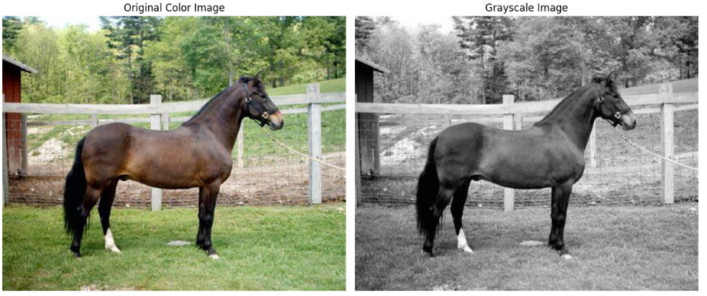
Results

Slide 12
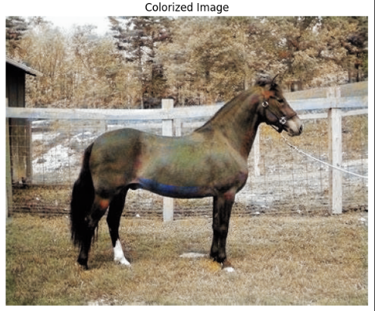
Results

Slide 13
Evaluation
The evaluation of a project focused on generating grayscale images using Generative Adversarial Networks (GANs) involves assessing various aspects such as the quality of generated images, the performance of the GAN model, and its ability to generalize to new data.

Slide 14
Conclusion
The conclusion of a project focused on grayscale image generation using Generative Adversarial Networks (GANs) summarizes the key findings, achievements, limitations, and potential future directions of the project

Slide 15
THANK YOU

